Slide 1



Team Storm Introduction
Shela: Main Artist
Jungbeom: Character Dev
Zhengwei: UI Dev
Jae Wong: AI Dev
Joel: Main Programmer,Game Designer, The Big Boss

Slide 2
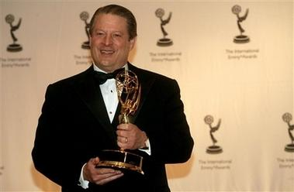
Monkey Storm
“World’s Best Game Ever”
DON’T HESITATE!!!!!!!!!
Nobel Prize Game

Slide 3
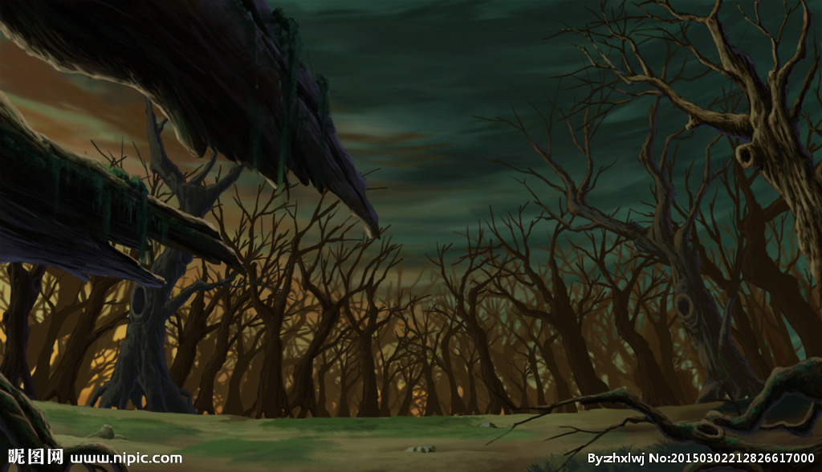



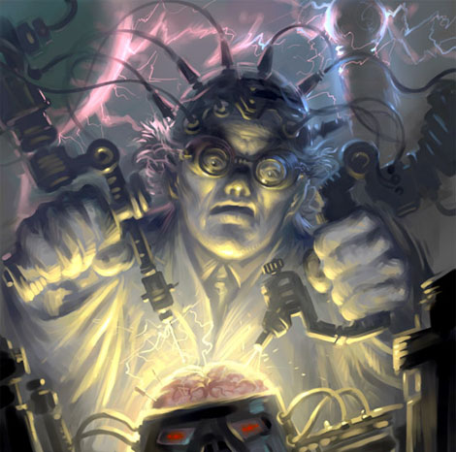
secret research center in jungle
The evil scientists
(Boss)
(scientists)

Slide 4



Background story
Evil Scientist Chacco (Player Monkey)
||||||||
Evil Monkey Faction Army(EMFA) bulldozer

Slide 5



Target
TARGET: IPHONE/IPAD, ANDROID ( ALL SCREEN TOUCH DEVICE)
TARGET AUDIENCE: Rated E For Everyone
NO SEX NO DRUGS NO VIOLENCE

Slide 6
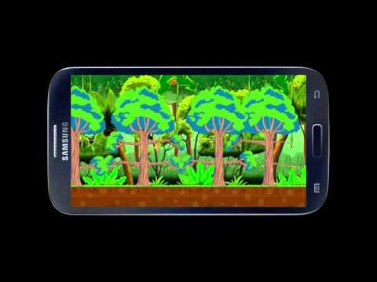
Here is A video About The Game.
video

Slide 7
Future Plans
LEVEL 2&3 coming soon…
UI Improvements
More movement types of characters in progress
More interactable objects and more challenges for Chacco such as adding banana objects

